Slide 1




A Guide to a Levels
Peter Symonds College

Slide 2


What are
A Levels?
Advanced level qualifications
Academic, subject-based qualifications
40+ A Level subjects are available nationally
Lead to higher education, employment or further training such as apprenticeships

Slide 3

How many A Levels can you do?
It is important to check what each college offers as it will differ
An A Level is taught over two years
Most students will study three A Levels for a full-time course at sixth form
Some subjects can be offered as a fourth course choice, but additional entry criteria will apply

Slide 4

How is an a level taught?
TIP:
take a look at individual course information for full details
Classroom-based, but you can also expect research/fieldwork, projects and group collaborations in many subjects
There are a variety of learning opportunities outside of the classroom such as trips, workshops, events, guest speakers
Notes:
Probably seen as the more traditional route at sixth form, A Levels are a popular choice for students looking to go on to further/higher education and training.

Slide 5
A BROAD CURRICULUM
Art | French (and AS Level) | Music Technology
Biology | Geography | Photography
Business | German | Philosophy
Chemistry | Graphic Communication | Physical Education
Classical Civilisation | History | Physics
Computer Science | History of Art | Politics
Dance | Italian | Product Design
Drama and Theatre | Latin | Psychology
Economics | Law | Religious Studies
English Language | Mathematics | Sociology
English Language & Literature | Further Mathematics | Spanish (and AS Level)
English Literature | Media | Statistics
Environmental Science | Music (and HSMC) | Textile Design
Film Studies | Music: HSMC | Three-Dimensional Design
Notes:
An example of what is offered at PSC
Almost any combination is possible
Guidance on art subjects
AS Levels in Fmaths, Spanish, French

Slide 6

A Mixed study programme
A Levels can be taken alongside vocational subjects
A wide choice of combinations can be available, giving students a study programme that suits them best
Allows students to have a mix of exam-based and coursework-based subjects

Slide 7
SAMPLE TIMETABLE
 | Monday | Tuesday | Wednesday | Thursday | Friday
0900-0955 | Biology | Mathematics
0955-1050 | Biology | Mathematics
1050-1110 Break
1110-1205 |  |  | Biology |  | Economics
1205-1300 |  |  |  |  | Economics
1300-1355 LUNCH | Tutor Group |  | Enrichment
1355-1450 | Economics |  |  | Mathematics
1450-1545 |  |  | Economics | Biology | Mathematics
1545-1640 |  |  | Economics | Biology | Mathematics
Notes:
An example to show how a timetable works
50% of work = the class sessions
Tutor and enrichment = important part of the working week
Independent study = critical for success

Slide 8
SAMPLE TIMETABLE
 | Monday | Tuesday | Wednesday | Thursday | Friday
0900-0955 | Further Maths | Chemistry | Physics | Maths
0955-1050 | Further Maths | Chemistry | Physics | Maths
1050-1110 Break
1110-1205 |  | Maths | Further Maths
1205-1300 |  | Maths
1300-1355 LUNCH | Tutor Group |  | Enrichment Rugby Team
1355-1450 |  | Physics |  | Chemistry | Maths
1450-1545 | Physics |  |  | Further Maths | Chemistry
1545-1640 | Physics |  |  | Further Maths | Chemistry
Notes:
An example of a student taking Further Maths as fourth subject
Not shown on the timetables are lunchtime workshops and additional support that students can access

Slide 9

How are A Levels Assessed?
Assessment is primarily via final exams at the end of the course
Many subjects will also include a non-exam assessment such as a coursework assignment

Slide 10

WHAT SUBJECTS SHOULD I CHOOSE?
CONSIDER:
What subjects you are good at and what you enjoy
A possible career path Keeping options open Studying something new

Slide 11

WHAT SUBJECTS SHOULD I CHOOSE?
Explore future pathways
Some career pathways, e.g. medicine, will have specific requirements
Careers advice can help you decide
which subjects/qualifications will
give you the best opportunities
Talking to subject teachers at college open evenings will help you
understand which courses will be
right for you

Slide 12

ENTRY REQUIREMENTS
YOU WILL NEED:
A minimum of five GCSEs
at grade 4+ including English and Maths.
However, all grades are important.
Some subjects will have specific entry requirements. Check the prospectus or psc.ac.uk for details.

Slide 13
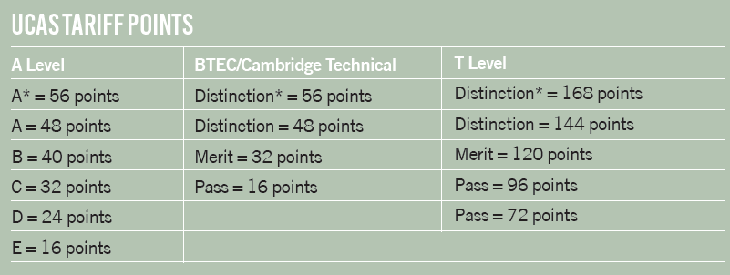
Progression
Each grade at A Level carries UCAS points
Universities set out their grade requirements but also if specific subjects at A Level are required

Slide 14





Thank you
peter.symonds.college
symonds_college
peter_symonds_college

