Slide 4
The challenge of natural hazards revision
Apply BUM
to the question
Decide on the PE/PEE/PEEL paragraphs, their type and number
Decide on the points
you want to make based on what you know
Begin to write your answer
Exam question: Using an example you have studied, suggest why the effects of a tectonic hazard vary between contrasting areas of wealth (6 marks)
What are the command words to be boxed?
What are the important words and keywords to be underlined?
Based on the marks, how many and what sort of paragraphs should you write?
Using and explain
example, areas, wealth, contrasting
2 x PEE paragraphs

Slide 5
The challenge of natural hazards revision
Apply BUM
to the question
Decide on the PE/PEE/PEEL paragraphs, their type and number
Decide on the points
you want to make based on what you know
Begin to write your answer
Exam question: Using an example you have studied, suggest why the effects of a tectonic hazard vary between contrasting areas of wealth (6 marks)
What key words could you include?
What cheeky facts could you include?
What connectives should you include?
Primary effects, secondary effects, LIC, HIC, standard of liv.
c.200,000 deaths, 1.5m homeless, 296 killed, 4100 homeless
for example, however, furthermore, as a result, in consequence

Slide 6
The challenge of natural hazards revision
Using an example you have studied, suggest why the effects of a tectonic hazard vary between contrasting areas of wealth (6 marks)
P: The effects of a tectonic hazard are…
E: For example in the Haiti earthquake of 2010,…
But in the Amatrice, Italy earthquake,…
E: This difference is because…
P: The secondary effects of earthquakes can also be worse…
E: For example in Haiti,…
But in Amatrice,…
E: This is due to…
usually greater in Low Income Countries than High Income Countries.
296 did
around 200,000 died
Haiti has a lower level of development. Hospitals were less well-equipped and collapsed so that they couldn’t treat the injured and there was no emergency plan.
in LICs than HICs, and an example is homelessness.
1.5m people were made homeless.
a few thousand were.
the people of Haiti living in huge areas of squatter settlements made of scrap materials which quickly collapsed, which is typical of LICs.

Slide 7
The Living World
Ecosystems
Tropical Rainforests – Where? Structure? Causes of Deforestation? Management – International, National and Local?
Hot Deserts – Thar – Where? Opportunities? Challenges?
Desertification – Where is it occurring? Why is it occurring? Reducing the risk?

Slide 8
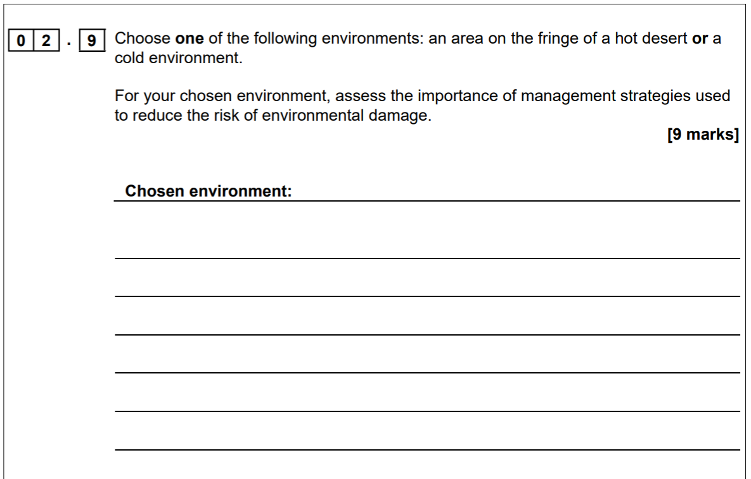

Slide 9
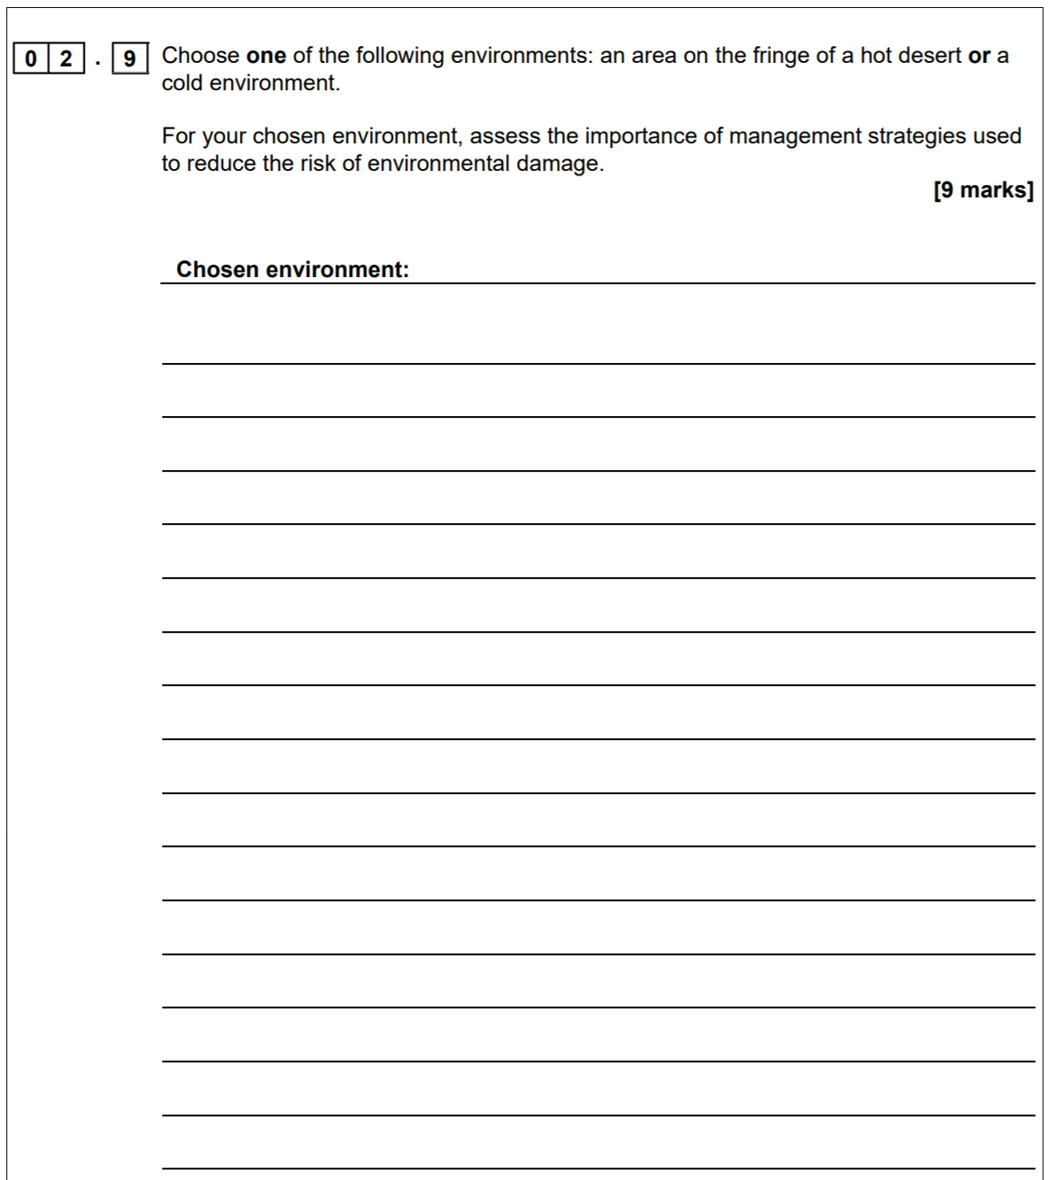
Chosen environment – Fringe of a Hot desert??

Slide 10
Sahel Region, Sahara Desert, Africa
1st job – identify the risk of environmental damage – what environmental damage is taking place?
Clue: Process by which land is turning to desert
Opening Statement showing understanding of what the risk is and where
The Sahel Region is at risk of environmental damage called desertification. This is the process whereby the land turns to desert.

Slide 11
2nd Job – Identify a management strategy used to reduce the risk of desertification.
a. How does it work?
b. How important is it?
X2 of these
Strategies?
‘Magic Stones’ aka Low Stone Walls
Planting trees – e.g. Acacia Gum Trees
Others…..
3. National Parks and Reserves
4. Water and Soil Management

Slide 12
One management strategy used to reduce the risk of desertification is the method called ‘Magic Stones’. Lines of low stone walls have been built by local communities along contour lines using stones from the surrounding area. When the rain comes, the walls trap the water, also preventing the soil from being washed away. Moisture is therefore held in the soil. This management strategy is very important. Not only has it helped to reduce desertification by preventing soil erosion, but it is also very sustainable as it uses appropriate technology. In areas of the Sahel where it has been implemented, farmers have been able to increase their crop yields by up to 50%. This means that there is enough food to feed the population in the region, therefore preventing food insecurity and famine from occurring.

Slide 13
A second management strategy used in areas of the Sahel which is also very important, is the planting of trees. In particular, in Senegal, they have planted Acacia Gum trees. Planting the trees reverses desertification by preventing soil erosion. The tree roots binds the soil together and the leaves and branches provide shade for plants and animals. The trees also provide an income for local people, nutrients for other plants and crops to grow, as well as providing fodder for livestock. This strategy has therefore been very important for reducing the effects of desertification by protecting the environment, but also in supporting local communities as well. This strategy is also very sustainable.

