Slide 1
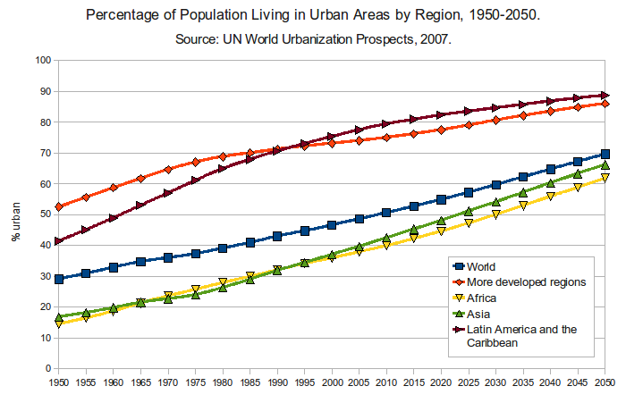
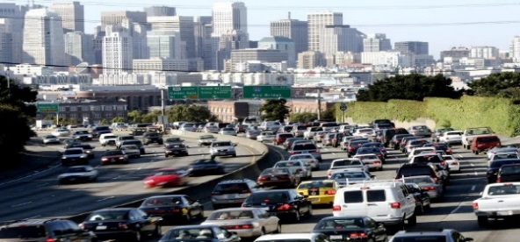
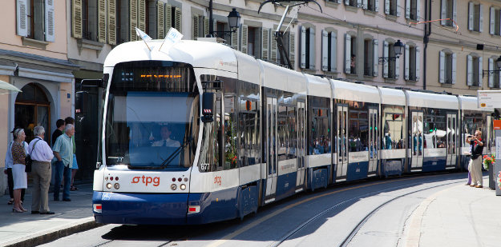
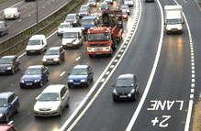
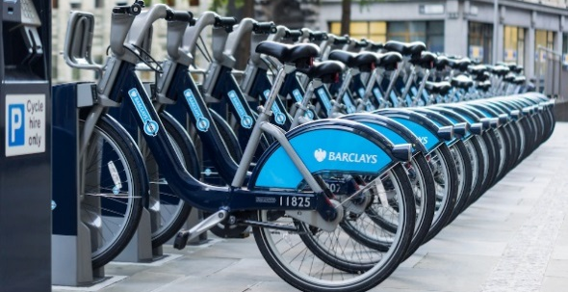
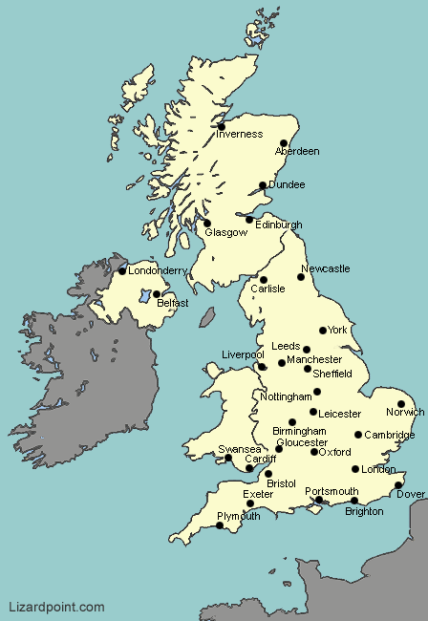
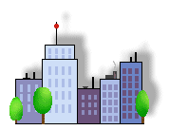
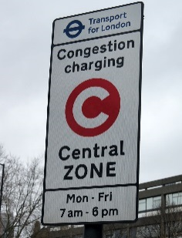
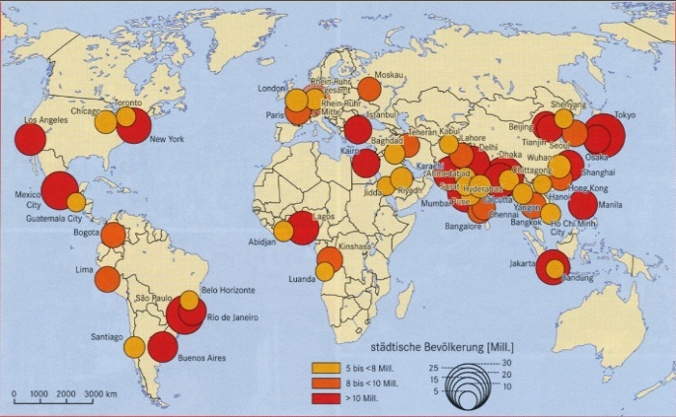
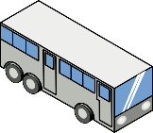
Urbanisation
Urbanisation is the increase in the proportion of people living in urban areas (cities). More than 50 % of the world’s population live in urban areas.
The pattern of urbanisation
Globally, the amount and rate of urbanisation varies: HICs have a more urbanised population (i.e. most people living in cities), but the rate of urbanisation is slowing; LICs and NEEs have a less urbanised population but the rate of urbanisation is accelerating.
Sustainable urban living
Sustainable urban living means living in a city but not polluting the environment or using up resources. Sustainable living should meet the social, economic and environmental needs of people. Sustainable cities are called liveable. Liveability means how easy, healthy and enjoyable a city is to live in.
Water conservation | Energy conservation
This is reducing the amount of water used, by: Rainwater harvesting, which provides water for gardens and for toilets Grey water (bathwater) for toilets and watering gardens Installing water meters which charge per amount of water used Installing dual flushes on toilets Educating people on using less water | Using less fossil fuel can reduce the rate of climate change, by: Promoting renewable energy sources e.g. solar panels, insulation, mini-wind turbines Making homes and appliances more energy efficient Encouraging people to use less energy
Creating green space | Waste recycling
Creating green spaces in cities (parks, green roofs) can improve places by: Encouraging people to walk or cycle Trees reducing the risk of surface runoff and flooding Trees reducing vehicle particulate pollution | Recycling means that fewer resources are used and waste rotting in landfill sites (and releasing methane, a greenhouse gas) is reduced by: Collecting household waste Offering local recycling facilities Educating people about recycling
Traffic management
Increasing incomes and populations mean that there are more cars or the roads of cities. This has caused urban areas to experience traffic congestion that can lead to various problems.
Environmental problems
Traffic increases air pollution by carbon dioxide. This is a greenhouse gas that leads to climate change More roads have to be built which takes over land and habitats
Economic problems | Social problems
Congestion can make staff and deliveries late which reduces productivity Greater risk of accidents and fines means insurance costs rise | There is a greater risk of accidents and harm to people Congestion causes frustration Traffic produces particulates that can affect health, for example, asthma
Traffic congestion solutions
More sustainable ideas: Build cycle lanes and create bike hire schemes Invest in public transport (bus, train) Have park and ride schemes Encourage car-sharing schemes by allowing shared cars in special lanes Use congestion charges to discourage drivers from entering city centres Less sustainable ideas: Widen roads to allow more traffic to flow more easily and avoid congestion but this takes up land Build ring roads and bypasses to keep traffic out of city centres
The two causes of urbanisation
1.Rural-urban migration | The movement of people from rural to urban areas. It happens because of push and pull factors
Push factors |  | Pull factors
These are negative factors that push people to move away from a place |  | These are positive factors that pull people to move to a place
Jobs in farming (long hours, low pay) Natural disasters, such as drought War and conflict Mechanisation (loss of farm jobs) Lack of opportunities and investment |  | Jobs in services and factories Better education and healthcare Increased quality of life Following family members Plenty of opportunities and investment
2. Natural Increase | When the birth rate is greater than the death rate (because one increases and the other decreases)
Increase in birth rate | Decrease in death rate
Rural-urban migrants are likely to be young and therefore fertile and have children | A higher life expectancy due to supplies of clean water, better living conditions and diet Improved medical facilities help lower infant mortality rates and raise life expectancies
Unit 2A (Paper 2: Wednesday 5 June, pm)
Urban issues and challenges
Distribution of population and cities in the UK
 | Most UK cities are in the south and east and the English Midlands. UK cities are on or near: Major rivers for importing raw materials and exporting goods (e.g. London (River Thames)) The coast for the same reason; they are ports (e.g. Liverpool (River Mersey)) Raw materials such as coal or wool (e.g. Leeds) Cities also developed industry and grew just because of human innovation and enterprise there (e.g. Birmingham - birthplace of the industrial steam engine).
Traffic management: London’s Congestion Charge and Low-Emission Zone
The London Congestion Charge Zone covers much of central London. Motorists are discouraged from driving in the zone by an £11.50 daily charge. Buses, taxis, emergency vehicles and low emission vehicles are exempt. Vehicles driving in central London are 10% lower. In 2019 the Ultra-Low Emission Zone (ULEZ) will be introduced, adding £15 to the cost of driving into central London (bringing the total cost to £26.50).
The growth of megacities
Megacity | An urban area with over 10 million people in it.
As a result of rapid urbanisation, the number of megacities is increasing. |  | More than two thirds of current megacities are located in either NEEs or LICs. The majority of megacities, and the fastest-growing ones are located in SE Asia. Africa also has many fast-growing ones.
Managing urban growth #1: Integrated Transport Systems (ITS) | Managing urban growth #2: Greenbelts
This means the linking of different forms of public and private transport within a city and the surrounding area, e.g. bus timetables coincide with train arrivals, park and ride stations are on the edges of cities where there is space for car parking. | This is a zone of land surrounding a city where new building is strictly controlled. This aims to prevent cities growing. Some road and housing developments are now being allowed on greenbelts (which is controversial).
Managing urban growth #3: Brownfield sites | Managing urban growth #4: Urban regeneration (gentrification)
A brownfield site is an area of land or that has been developed before. It has since become derelict and can be re-used e.g. shipping scrapyards at Tipner in Portsmouth rebuilt for homes. Brownfield sites are more expensive to develop than greenfield sites as derelict buildings must be removed first. | This is the improvement of run-down inner city areas (often brownfield sites). Old warehouses and factories in inner city areas such as Gunwharf Quays are refurbished and converted into flats or leisure facilities (the Vulcan Building at Gunwharf became Loch Fyne and the Aspex Gallery).

Slide 2
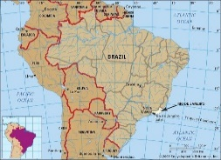
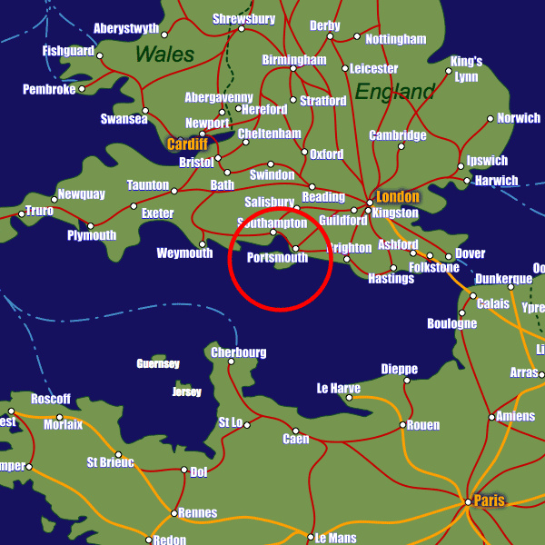
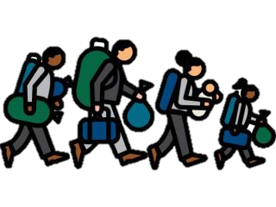
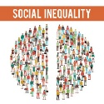
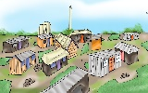
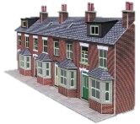
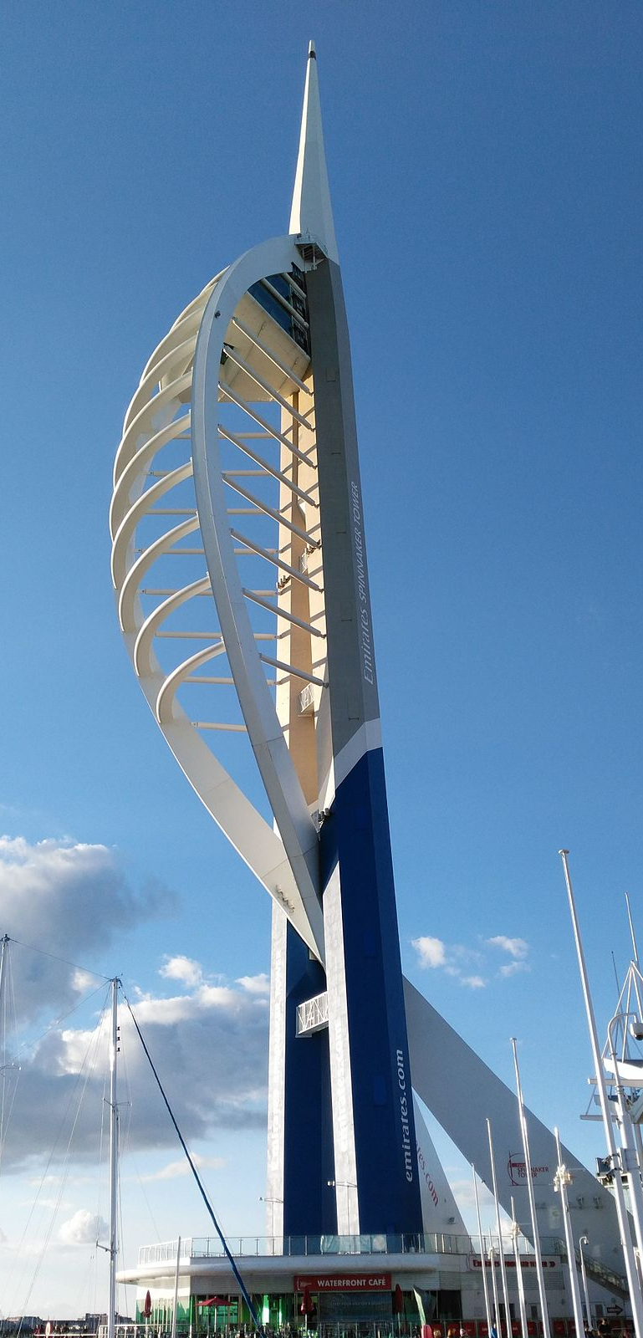
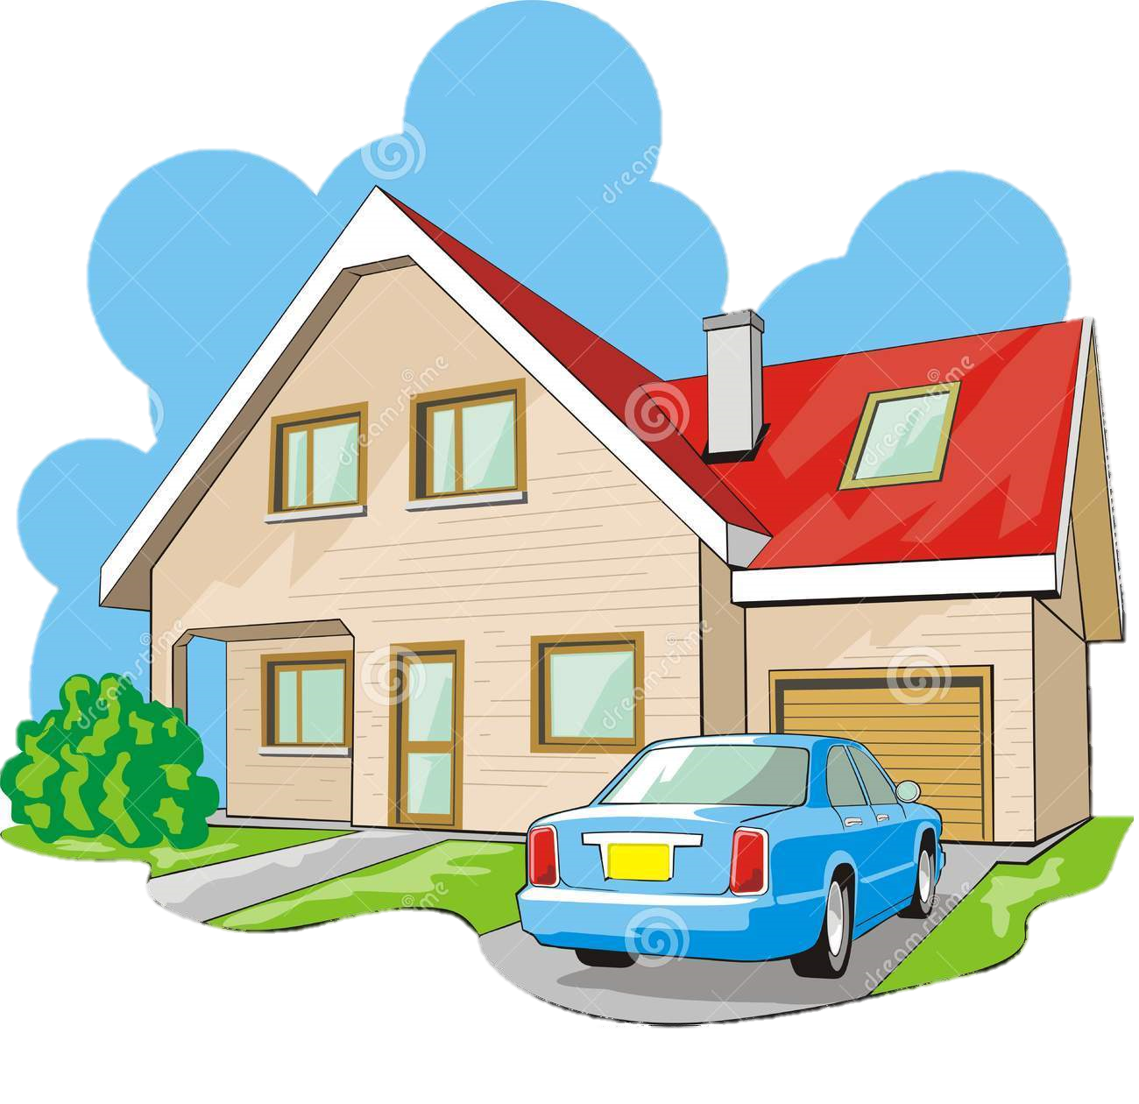
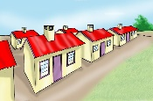
Case study for urban change in a major UK city: Portsmouth
Location and background |  |  | Portsmouth’s importance
Portsmouth is: On the south coast Home to 205,000 people On an island – Portsea Island, making it unique |  | Portsmouth grew as a naval base. It is home to two thirds of the UK surface fleet. It has lost its industries of shipbuilding, brewing and weapons-making | National importance: A university in the top 25 globally, and two cathedrals Part of the UK’s 8th biggest and 5th richest urban area (along with Southampton) Home to the royal navy which protects the UK and helps trade
 |  |  | International importance: European Head Office for IBM (at North Harbour, Cosham) Satellites for European Space Agency made at Astrium (Hilsea) 5th most visited city in UK due to Historic Dockyard Some FDI (foreign direct investment) from global firms such as IBM and EADS Astrium which have set up in the city
Migration to Portsmouth
The city has little ethnic diversity but this is changing
History of migration: Portsmouth is less multiethnic than many UK cities (it is 84% white). Even so: 1850-1900: from UK (for navy work), Ireland (digging railways and docks) and Hong Kong (navy laundry) 1950-1980: very little immigration from ex-colonies (India, Pakistan, Nigeria) due to navy ban on foreign personnel 2000-present: mostly from E Europe: Poland, Romania and from war-torn areas: Somalia, Iraq 2010-present: students (UK and foreign as uni grows) Much of this migration was international, most was voluntary/economic (e.g. Poland, Ireland), some was forced (e.g. Somalia, Iraq). |  |  | Portsmouth’s opportunities
 |  |  | Portsmouth is changing, creating challenges and opportunities
 |  |  | Social opportunities: An increasingly diverse culture: Migrants and students have given Portsmouth a better cultural scene (two theatres, Guildhall) Massive expansion of university attracting more students who are now 11% of Portsmouth’s population and help the economy
 |  |  | Economic opportunities: Traditional manufacturing industries have closed and replaced with new tertiary and quaternary ones: Portsmouth is the UK home to IBM (servers), EADS Astrium (satellites). These were attracted by location, transport connections, existing naval technology and quality of tech graduates from the University of Portsmouth New shopping centre of Gunwharf Quays with 1000 jobs
Effects of migration: Increased productivity in hospitality, manufacturing, retail and health, as migrants are hard-working Cultural enrichment, e.g. Chinese New Year festival Youth to balance the locally ageing population Some cost of integrating children at school Some extra pressure on housing and services Social divide between students and locals
 |  |  | Environmental opportunities: These improve the city: Improved public transport: park and ride from Tipner on the M275; ‘smart’ buses; The Hard interchange was redeveloped Improved SSSIs: Hilsea Lines (hedgerows, woodlands) protected by wardens and information boards; old sea defences (which cause saltmarsh squeeze) removed alongside Langstone and Portsmouth Harbour saltmarshes and mudflats
Portsmouth’s challenges
Social challenges: Social inequality is when people have unequal, unfair access to health, housing and education. Social depriv-ation is when people don’t have their basic needs met such as a good diet | Two contrasting areas: 1. Fratton – an inner city area Low educational attainment High crime rate Low life expectancy (77) 29% youth unemployment |  | Example of regeneration: Gunwharf Quays
 |  |  | The need for regeneration: Huge derelict navy base for weapons testing (HMS Vernon) Prime waterfront location and a central location close to bus terminal (The Hard), railway station and ferries
 | 2. Farlington – a suburban area on the rural-urban fringe High educational attainment Low crime rate High life expectancy (83) 3% total unemployment |  | The regeneration: A mixed-use development: residential area separated by a waterway from a leisure and retail area (outlet shops, cinema) Landmark Spinnaker Tower (170m tall) and ‘Lipstick Tower’ flats Historic ‘Listed’ buildings such as Vulcan Building re-used Design mostly in redbrick to blend with city
Environmental challenges: Economic changes have created problems for the environment: No Integrated Transport System linking rail and bus Saltmarsh squeeze around the harbours Little recycling and green energy (except Gunwharf) Some of the rural-urban fringe area of Portsdown Hill has been developed adding to urban sprawl |  |  | The success of the regeneration: Social: new community created; highly popular place to visit Economic: attracts visitors to Portsmouth but takes shoppers away from Commercial Road and Palmerston Road high streets Environmental: Largest array of solar panels in a shopping centre in Europe; recycling bins; next to The Hard bus interchange and railway station; area of waterfront opened up
Case study for urban change in a major NEE city: Rio de Janeiro, Brazil
Location and background |  | Rio’s importance
Rio de Janeiro is: On Brazil’s Atlantic coast in the south Home to 12.5m overall |  | National importance: Rio is: A destination for internal migrants from rural Brazil Home to many of Brazil’s banking, insurance and oil firms
Parts of Rio: Rio has four zones: North Zone: industry, port, low-cost housing (favelas) West Zone: industry, high-cost housing, Olympic site South Zone: beaches, high-cost housing, Roçinha favela Centro: CBD, historic buildings, company headquarters |  | International importance: Rio is: (Was) host of 2014 World Cup and 2016 Olympic Games Very popular for tourism due to stunning mountains (such as Sugarloaf) and beaches (such as Copacabana) A major global financial centre
Rio’s challenges |  | Rio’s solutions to its challenges (on the left)
Social challenges… Healthcare: 45% residents can’t access a clinic. In favelas, life expectancy levels are lower than average Education: very few children stay in school past 14 years because of a lack of staff and free school places Water supply: 12% of Rio’s pop didn’t have clean water |  | …and their solutions: In Santa Marta favela, a steep hillside and no roads prevent people visiting a clinic, so staff take health kits to people’s homes Local people volunteer to help in schools. Poor families are given grants to help them attend New pipes and treatment plants installed
Economic challenges… Unemployment: Lack of jobs means that people work in the informal economy as drivers, labourers, maids, prostitutes, but the work is poorly paid and uninsured Crime: robbery, murder, kidnapping, drug trafficking |  | …and their solutions: To reduce youth unemployment, education in essential skills; to reduce adult unemployment, courses in essential skills are offered with free child care Policing stepped up with Pacifying Police Units near Olympic sites
Environmental challenges… Traffic congestion: narrow spaces for roads due to steep relief; increasing population using cars too Water pollution: Guanabara Bay is polluted with indust-rial and household wastewater washed in by rivers Waste pollution: No refuse collections in the favelas |  | …and their solutions: Metro system has been expanded and extended; new toll roads into city centre 12 new sewage works; ships are fined for washing out their fuel tanks at sea; new sewage pipes in city Refuse collected by hand; a waste incinerator power plant set up
Managing the growth of squatter settlements |  | Example of sustainable urban living: Freiburg, Germany
Squatter settlements are slums, called favelas in Brazil. Too many people arrive in the city to be housed, so they build their own houses on land that is not theirs. |  | Location and background: Freiburg is in SW Germany. It set a goal of urban sustainability in 1970 (sustainability means using resources but not using them up or harming them)
The challenges of squatter settlements: Housing: Houses built of scrap materials on hillsides and riverbanks, at risk from fire, landslides and floods Services: Little clean water and electricity, so people tap into the mains. Sewage flows down the street Health: High population density, high infant mortality, few doctors, lots of rubbish pile up to spread illness |  | Planning in Freiburg: Social planning: This provides for people’s needs, especially warm, secure homes and community facilities. In Freiburg local people are involved in all planning decisions and invest in green energy Economic planning: This provides for people’s incomes. People need well-paid, secure jobs with enough time off. In Freiburg many jobs are in renewable energy, especially solar energy Environmental planning: This ensures the environment is not harmed. Reducing waste and using renewables are essential.
Example of improving a squatter settlement: Roçinha Roçinha is the largest favela in Rio, located on a hillside. This is an example of low-cost improvements, in which people do-up their homes bit by bit. As a result: Almost all houses have been rebuilt with brick Almost all have electricity, running water and sewerage Shops, schools, clinics, and a private university set up
 |  | Sustainable living in Freiburg: Sustainable water supply: reducing water use by using grey water, rainwater harvesting, pervious pavements, green roofs, wetlands, flood water storage from the River Dreisam (also reduces floods) Sustainable energy supply: reducing energy use and replacing it with renewables by: energy efficiency, solar power, biomass (from wood chips) and biogas (from organic waste). The city aims to be 100% renewable energy by 2050 Sustainable green spaces: trees prevent flooding, attract wildlife and clean the air. 40% of city is forested Sustainable transport: using an integrated transport system, cycle lanes, bike and ride, car parking restrictions
Example of planning for Rio’s poor: Favela Bairro
This is a site and service scheme in which new houses are built. Streets are paved, sanitation is provided, Hillsides stabilised, a cable car installed, and access to credit and mortgages improved.

