Slide 1
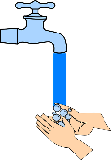
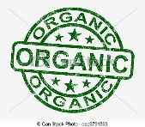
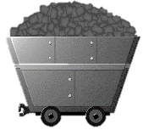
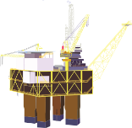
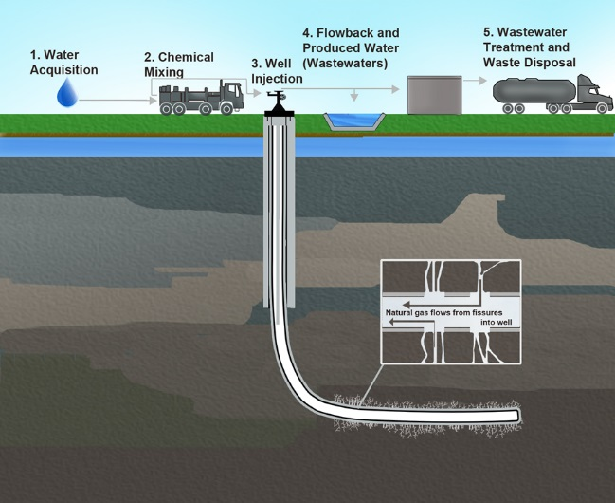
Resources key terms
Key term | Definition
Resources | Materials that people need. They may be needed for basic survival e.g. water, or appreciated as something that improves quality of life e.g. coffee beans.
Resource management | The control of resources so they don’t become depleted (run out).
Surplus | When there is more of a resource than is needed to meet demand.
Deficit | When there is not enough of a resource to meet demand.
Demand | The amount of a resource needed or wanted by people
Carbon footprint | The amount of carbon dioxide released into the atmosphere by people or a country
Wellbeing | Being happy, healthy and personally fulfilled. Social and economic wellbeing are important.
The significance of food, water and energy to economic and social well being
Water food and energy are key for human wellbeing. All lead to social and economic benefits, which all increase the standard of living and quality of life.
Food | People have access to safe, nutritious food, so… They don’t get ill from undernourishment, and so… Adults can work, so can earn a good income and pay taxes which can be invested in schools and roads, and… Children can attend school and get an education, so they can earn a good income and pay taxes and so on. But if they don’t have access to nutritious food, the opposites happen.
Water | People have access to safe, clean water, so… They don’t get ill from water-borne diseases like cholera, and so… Adults can work, which means they can earn an income and contribute to a country’s taxes and GDP, and… Children can attend school and receive an education, and so on. Also, industry can use the water which raises a country’s GDP. But if they don’t have access to clean water, the opposites happen.
Energy | People and have access to energy, so… Adults can work in industry, which means they can earn an income and contribute to a country’s taxes and GDP, and… Children can attend school and receive an education, and so on. Plus, homes are warm and lit and transport can happen.
Opportunities and challenges created by changing demand for food in the UK
Demand is growing for food generally | The UK’s population is growing. This is due to immigration and a relatively high birth rate for an HIC. People are also being more wasteful with food due to time constraints and following food fashions. Some areas of the UK can’t grow food because they are too mountainous and cold.
Demand is growing for exotic and out-of-season food | People want more exotic food, such as avocados and mangoes. They also want the same foods all through the year such as strawberries and asparagus (which are British summer crops).
Carbon footprints, food miles and environmental damage | As a result of these challenges, much of our food is imported. It is grown in foreign countries and imported by sea or air. This leads to huge water and carbon footprints. Food miles means the distance food has travelled from where it was grown to where it is eaten. The term measures the food’s greenhouse gas emissions.
Agribusiness | Agribusiness means farms run by big business rather than individual farmers. It uses intensive farming. This means a lot of capital (money) is invested in machinery, technology and chemicals (pesticides and fertilisers). It has a huge environmental impact. Bees and beneficial insects are killed with insecticide; fertilisers cause pond weed to choke streams; hedgerows are pulled up and biodiversity decreases.
Organic food | As a result of these environmental concerns, people are increasingly trying organic food. Organic food is grown without artificial chemicals, usually locally, to reduce food miles and with concern for the environment.
Global inequalities in resource supply and consumption (use)
Food, water and energy are unequally shared out around the world. HICs tend to use more than their average share, LICs tend to use less.
Food | Many people in HICs consume over 3000 kcal each day (the recommended amount is 2000-2500 kcal), but in many LICs it can be less than 2000 kcal. Undernourishment (too few calories) is a problem in LICs and can lead to diseases Malnourishment (too many calories/not enough vitamins and minerals) is a problem in HICs. It often leads to obesity, diabetes and heart disease Food demand is increasing. This is a result of increasing population and changing taste in food.
Water | Water footprint is the amount of water used per day. People in HICs have a much larger water footprint than people in LICs. Water scarcity is when demand is greater than supply. It can be physical (e.g. drought) or economic (e.g. lack of capital to invest in clean water supplies).
Energy | Countries can both import and export energy. Some countries do not have their own sources of energy and rely on imports, such as the UK relying on Russia for its gas.
Changing demand for energy in the UK creates opportunities and challenges
The changing energy mix | The UK uses an energy mix, i.e. its energy comes from lots of different sources, from fossil fuels (coal, oil and gas) to nuclear, to renewables like solar and wind. The proportion of fossil fuels has decreased, and the proportion of renewables has increased.
Decreasing domestic supply of oil, coal and gas. | Reserves (stores) of North Sea oil and gas are running out. EU regulations (rules) on greenhouse gas emissions have led to a decrease in fossil fuel use. Energy efficient appliances and industry mean less energy is used in homes and industry.
Economic and environmental issues linked to energy use. | It is cheaper to import coal to the UK than to mine it, so coal is still used top generate power. Nuclear power stations are being decommissioned (taken down) and only one new one (Hinkley Point C) will be built. There is opposition to nuclear: massive costs, leaks, waste disposal. Economic concerns about energy include costs, jobs, set up costs, research, reliability. Environmental concerns include waste, noise, emissions, pollution, radiation leaks.
Fracking: opportunities and challenges
Fracking is short for ‘hydraulic fracturing’. Water with chemicals is pumped into shale rock. The pressure breaks the rock, releasing the trapped gas. Opportunities Shale gas could be widely available in the UK. It will provide slightly cheaper and more gas. The UK will be less reliant on enemy states like Russia for its gas supply. | Challenges The water used becomes toxic and poisons groundwater. Some methane (a greenhouse gas) escapes. The process uses huge amounts of pure water. Renewables are cleaner.
Unit 2C (Paper 2: Wednesday 5 June, pm)
The challenge of resource management

Slide 2
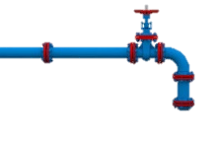
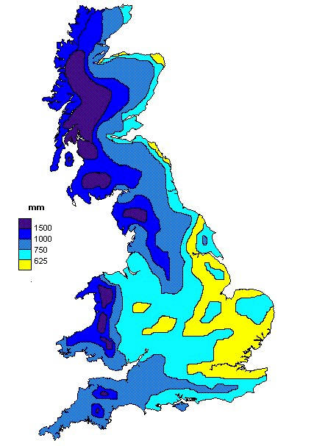
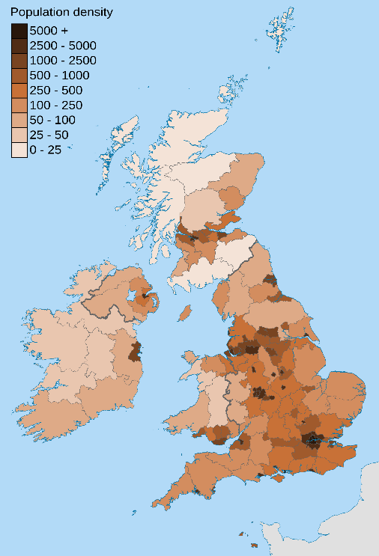
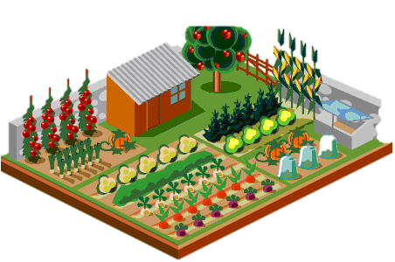
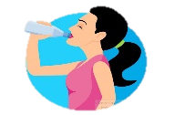
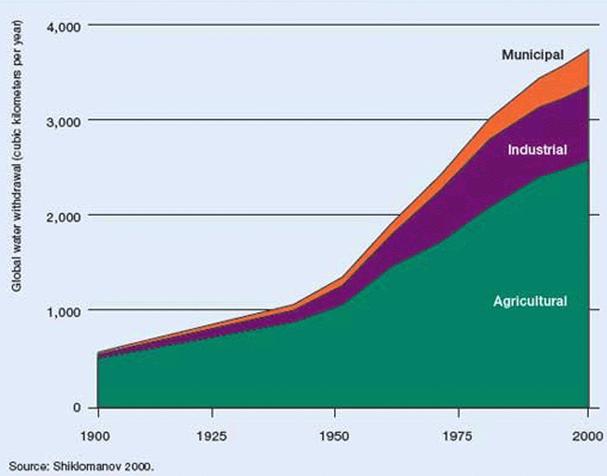
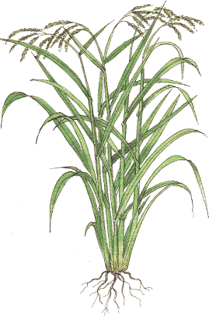
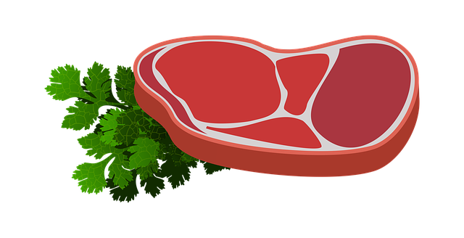
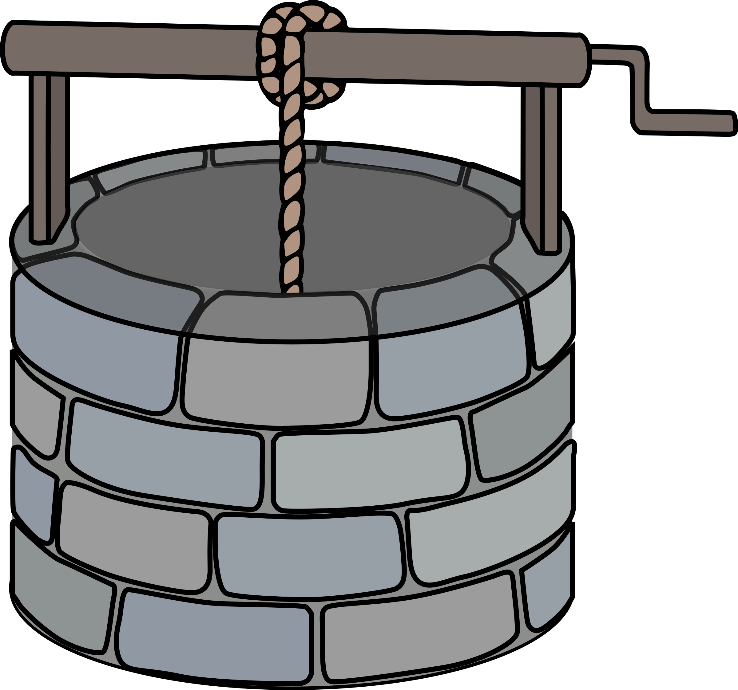
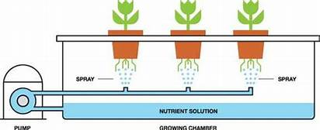
Resource security key words
Key term | Definition
Water/food/energy security | Having a steady supply of sufficient clean water/healthy food/energy (this is when water/food/energy supply exceeds water/food/energy demand)
Water/food/energy insecurity | Not having a steady supply of sufficient clean water/healthy food/energy (this is when water/food/energy demand exceeds water/food/energy supply)
Coping with the UK’s water deficit 1: transferring water
Many reservoirs in the UK transfer water from areas of supply to areas of demand. For example, Kielder Water supplies Newcastle. This is done by way of pipes. There are plans to transfer water even further, e.g. from Kielder Water to London. These plans have been put on hold due to the cost and impact to the environment.
Impacts (effects) of food insecurity (food insecurity is when there isn’t enough food)
Famine | Under-nutrition | Soil erosion | Social unrest
Famine is a large-scale shortage of food, causing undernutrition, starvation and death. | Undernutrition is having a diet that lacks sufficient calories, vitamins and minerals. (Malnutrition has a similar meaning.) | Soil erosion is when soil is washed or blown away. It happens because of: Overgrazing: cattle and goats eat too many plants. The roots can no longer hold the soil together. Overcultivation: Farmers grow too many crops and exhaust the soil of nutrients Deforestation: Trees are removed so that crops can be grown. The soil is then exposed to the rain and wind. | When an essential resource like food is scarce, people will fight over it and riot at their governments.
Coping with the UK’s water deficit 2: using less water
Water can be saved by using: Water meters: these charge for the actual amount used; Rainwater harvesting: water butts collect rainwater to water gardens; Grey water: water used for washing can be used to flush toilets.
Water supply, demand and deficit in the UK
Factors affecting food supply
Climate | Areas with a wet climate that is either mild or warm can grow food. Areas that are too dry, either very cold or very hot, cannot.
Wealth | HICs and NEEs can afford technology, machinery, irrigation and fertilisers so can grow food if their climate is wet enough. LICs cannot afford technology, machinery, irrigation and fertilisers so grow food using lots of labour (workers).
Infrastruc-ture | HICs have irrigation systems, dams and reservoirs, and good roads, storage and production facilities for food growing and transportation. LICs lack these.
Conflict | The enemies’ crops can be deliberately destroyed by armies.
Strategies to increase food supply
1. Irrigation This is artificially watering land so crops can be grown. Large-scale schemes use huge dams to benefit agribusiness Small-scale ones use water tanks to help poor local farmers. But excessive irrigation in arid areas can create salinization (salt rises to the soil, poisoning it) | 2. Biotechnology This adapts living organisms so that they are more useful. Genetically Modified (GM) crops can produce higher yields (harvests), use fewer chemicals or reduce CO₂ emissions or not need pesticides But people are worried about ‘frankenfoods’.
3. Aeroponics and hydroponics This is growing plants in air or water rather than soil to deliver nutrients directly and speed-up growth. There are two ways: Aeroponics grows the crops hanging in air with a fine mist giving nutrients Hydroponics grows the crops in water with nutrients | 4. Appropriate technology (intermediate technology) This is when poor farmers in LICs use skills and materials that are cheap, simple and easy to find and replace. For example, a bicycle can be adapted into a machine that removes the husks of coffee beans in Kenya.
Strategies to grow food sustainably
1. Organic farming Organic food is grown without artificial chemicals, usually locally, to reduce food miles. It is more expensive than inorganic food. | 2. Urban farming This is growing food in cities, such as on roofs or balconies or in allotments. It reduces food miles, creates local jobs and attracts wildlife.
3. Sustainably-sourced fish This uses quotas (limits) to stop too many fish being caught. The nets let the fry (baby fish) escape to grow into adults. But, too many fish are still caught which have to be thrown away. | 4. Sustainably- sourced meat This is produced in small farms by organic methods. Animal welfare standards are higher. It is more expensive than other meat.
Water supply Most UK rainwater falls in the north and west The source of all drinking water is precipitation (although it may be sored in reservoirs or aquifers (porous rocks underground). In the UK, most rain falls on the mountains and moors of the north and west, such as Scotland, Wales and Cornwall. | Water demand Most UK people live in the south and east In the UK, most people live in the south, the east and the Midlands where there is flat relief. These are also the driest areas. As a result, there is a mismatch between water supply and water demand. This is called water deficit or water stress.
Example of a local scheme to increase food supplies sustainably
Rice-fish farming, Jamalpur Province, Bangladesh
Sustainably means to not use up resources so that they are available for future generations. Jamalpur in Bangladesh has pioneered an approach which is spreading over SE Asia. The United Nations’ Food and Agriculture Organisation (FAO) provides training, funding and supplies. | Technique: The watery rice fields (paddies) are netted to stop birds. Fish are introduced to the rice paddies and breed. The fish and rice are mutually beneficial: the fish eat insects that eat the rice plants; the fish faeces fertilise the soil . The people harvest the fish and rice. Benefits: Social: Farmers get a balanced diet of carbs and protein. It also brings the community together. Economic: Farmers receive an income from selling the surplus, so they can send their children to school and buy goods. Environmental: Artificial fert-ilisers and pesticides are not required. Wild fish stocks are left alone and not overfished.
Water consumption
Demand for water is increasing globally. This is due to: Increasing population in LICs and NEEs; Increasing use of appliances that use lots of water such as coffee machines and dishwashers, especially in HICs and NEEs

